Slide 1
Public Health Applications for TEMPO
Susan Alexander, Mike Newchurch, Todd McKinney, Shi Kuang, Aaron Naeger, Paula Tucker, Darby Stevenson
University of Alabama in Huntsville

Slide 2
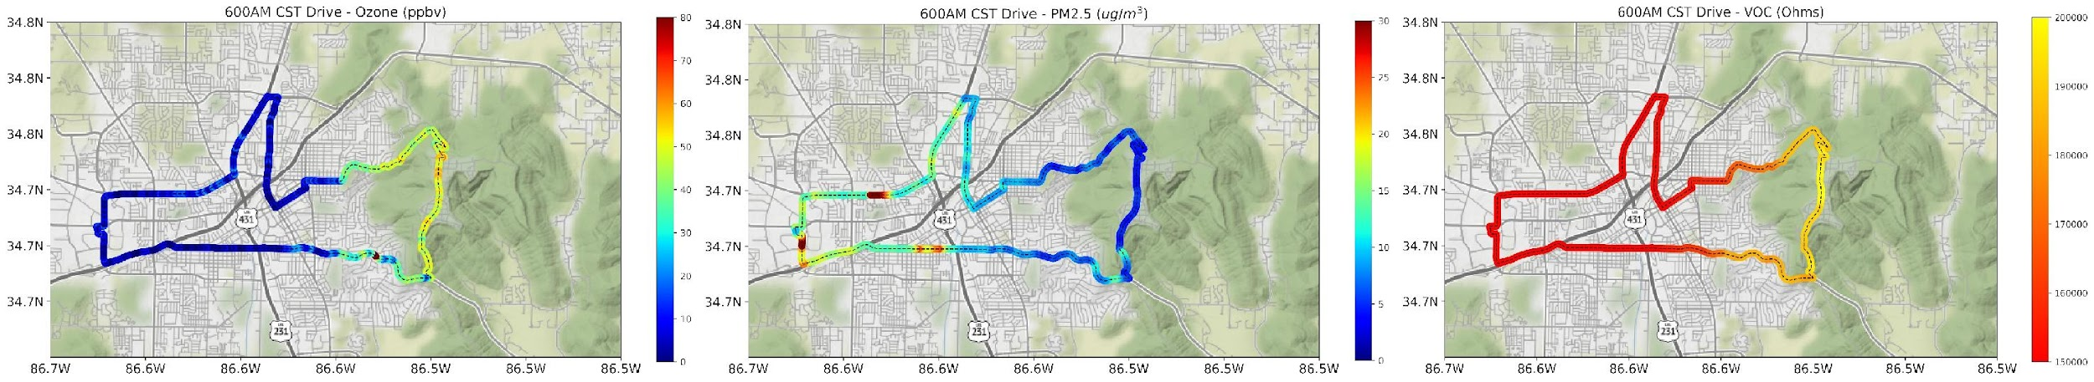
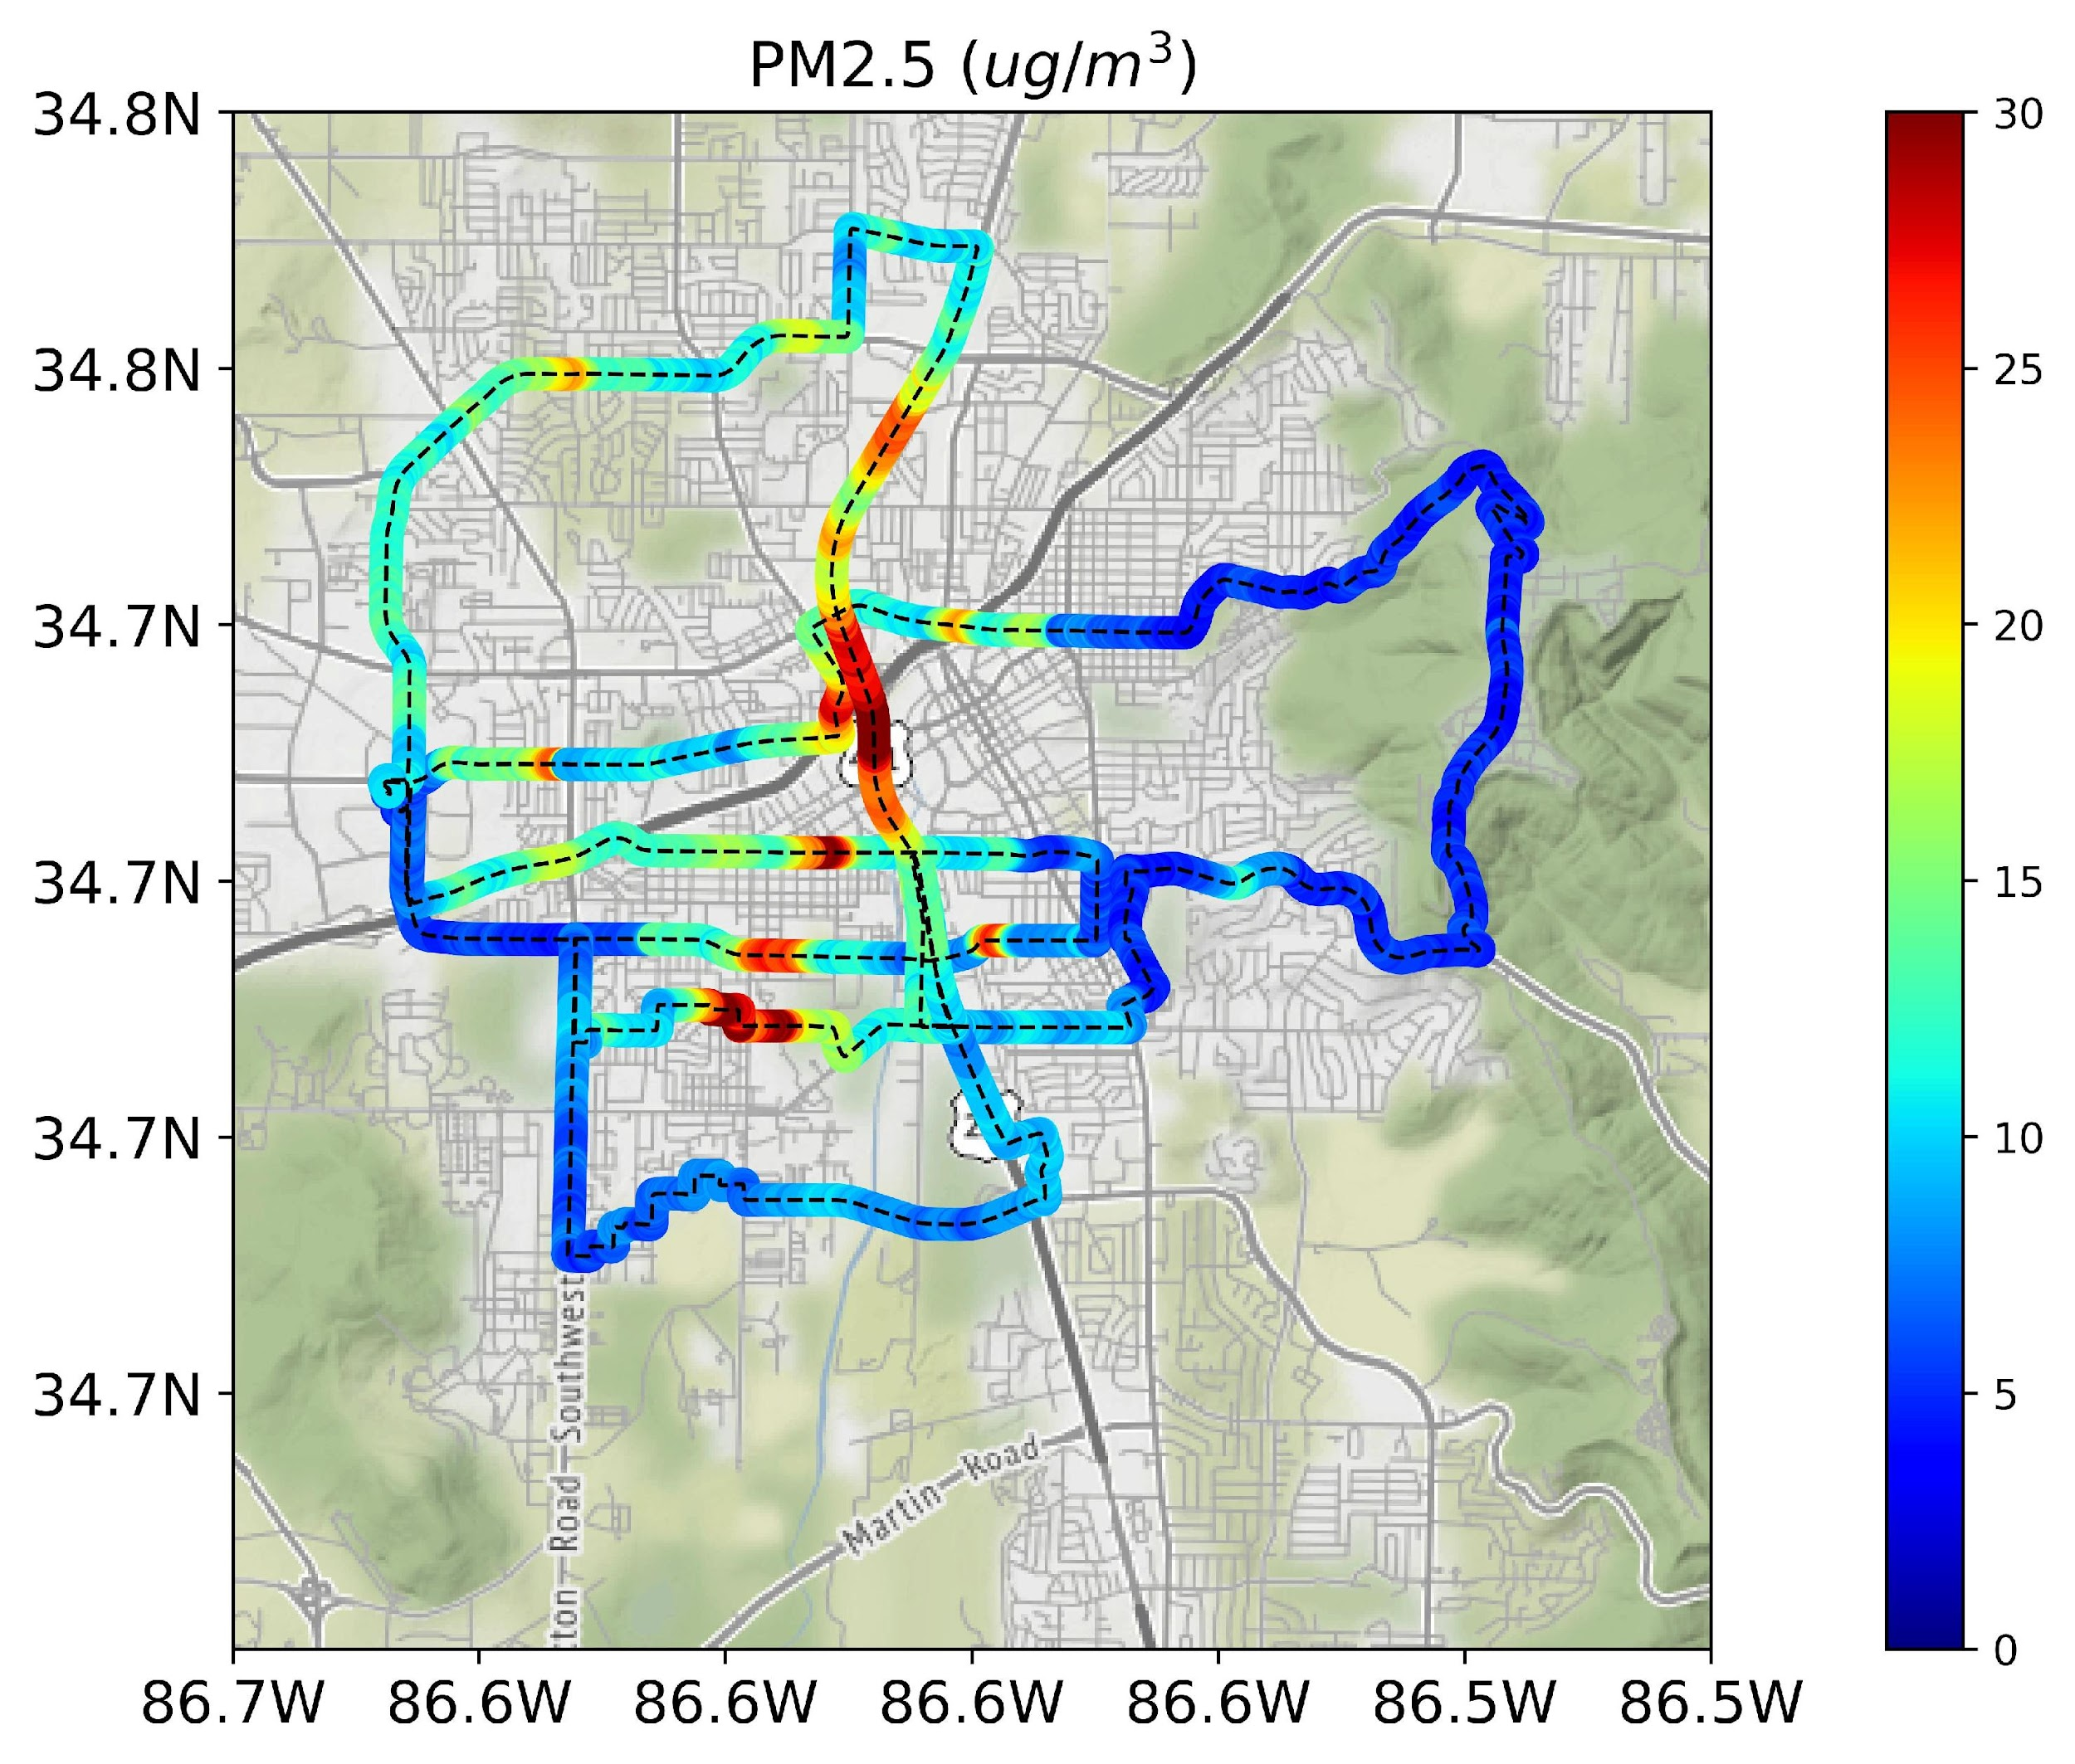
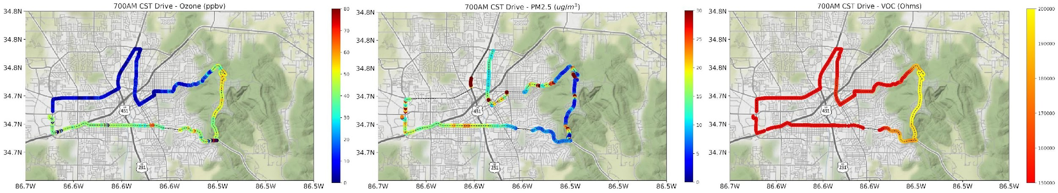
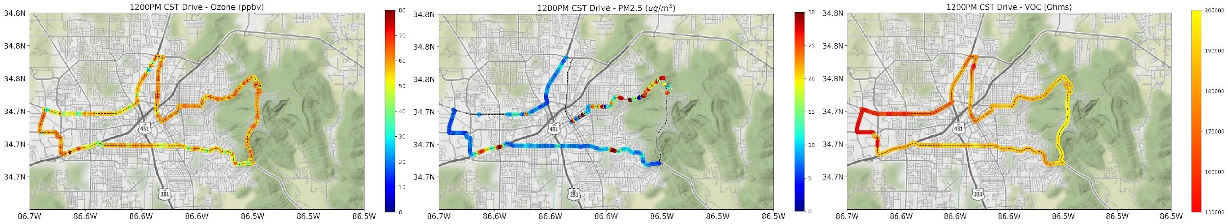
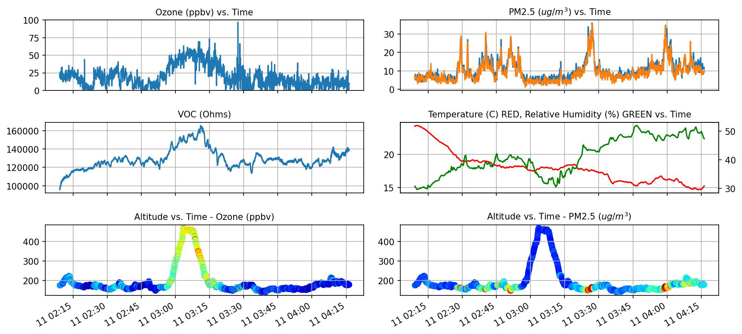
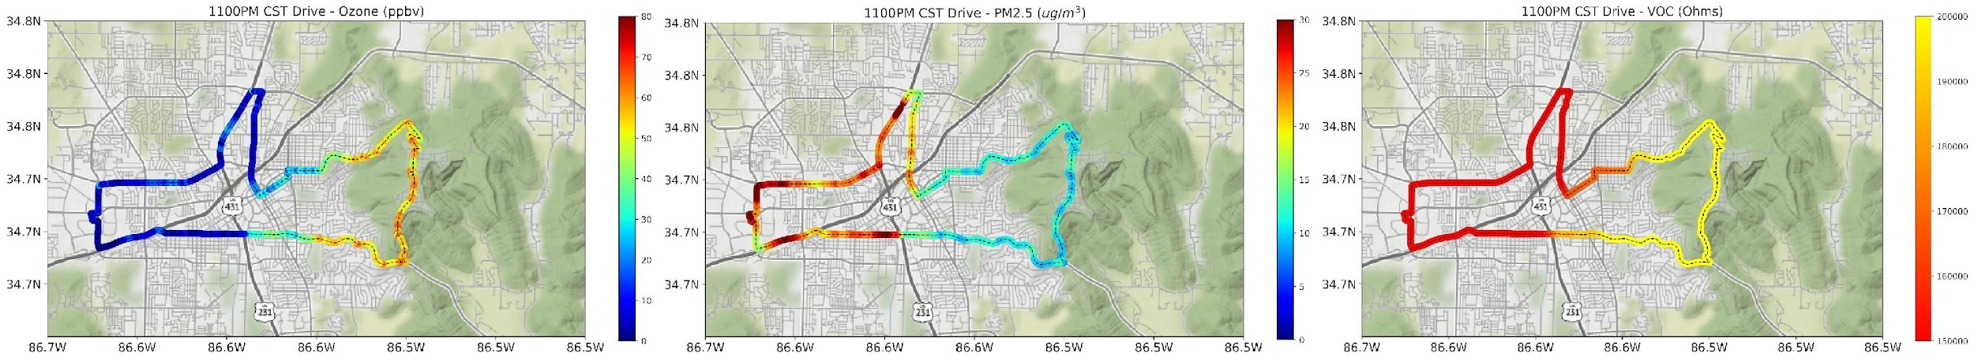
TEMPO: Health Applications
1)
o
Urban Plumes in Stable Layers
PM2.5 measurements made during night time in
Huntsville 11 April 2023, (b) PM2.5 vs. time (UTC).
I
1) Gradient in ozone mixing ratios between Monte Santo and Huntsville; same gradient that was measured at 6AM was measured 17 hours later at 11PM LT.
2) Higher ozone and VOC on Monte Santo. Higher ozone remains even after evening transition.
McKinney, T., Newchurch, M., Kuang, S., Alexander,S., Tucker, P., Stevenson, D., Mills, M., Perlaky, N. Exploring Spatial and Temporal Air Quality Gradients Using a Mobile Vehicle: The Road to TEMPO Evaluation.

Slide 3
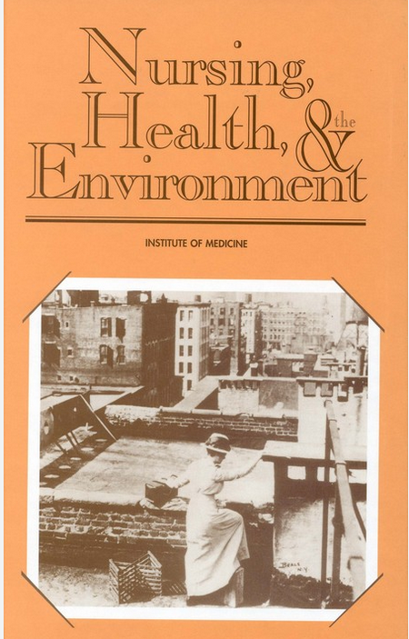
Health Implications
Acute/Chronic exposure risk estimates at hyperlocal scales
  Gradients
  Diurnal Variability
Perceptual responses to acute/chronic air quality changes
  Sensory
  Risk
  Behavioral implications
Needs
  Metric for diurnal variability PBL O₃ and NO₂
  Method for exposure notification to broader health community
“...the environment is a primary determinant of health,”

